Slide 1

Advanced Project Housing App
Georgi MaNev
Andrei Stefan

Slide 2
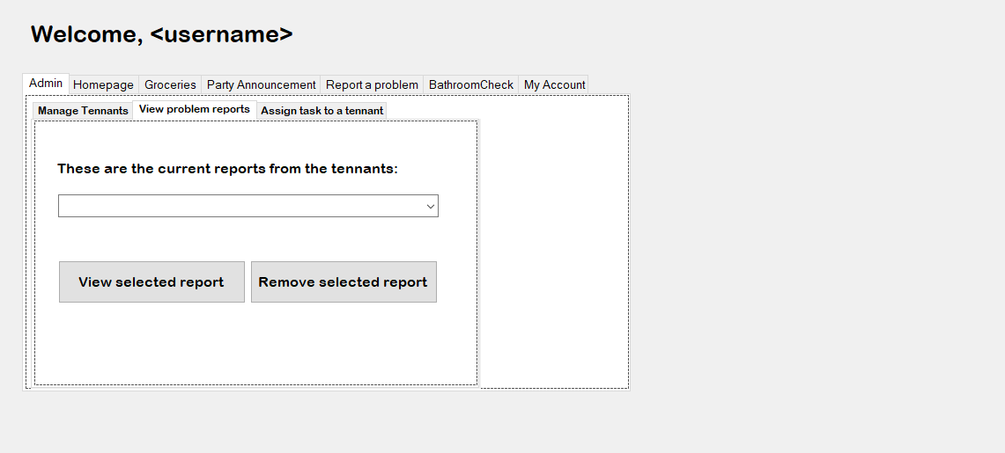
Interface of the app

Slide 3
Features
Garbage/Cleaning schedule
Party announcement and voting system
Problem report system
Groceries manager/paying system
Balance(money) system
Login system

Slide 4
Implementation
One database with multiple tables
Using queries to get the required data
Using queries to save the data into the tables
Tab Page to navigate the different features

Slide 5
Ask us some questions!

